Slide 1
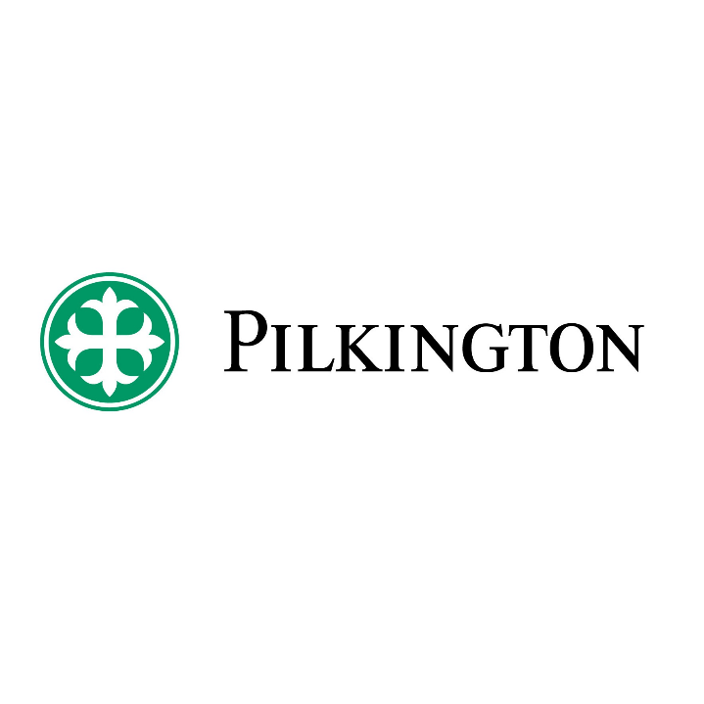

Slide 3
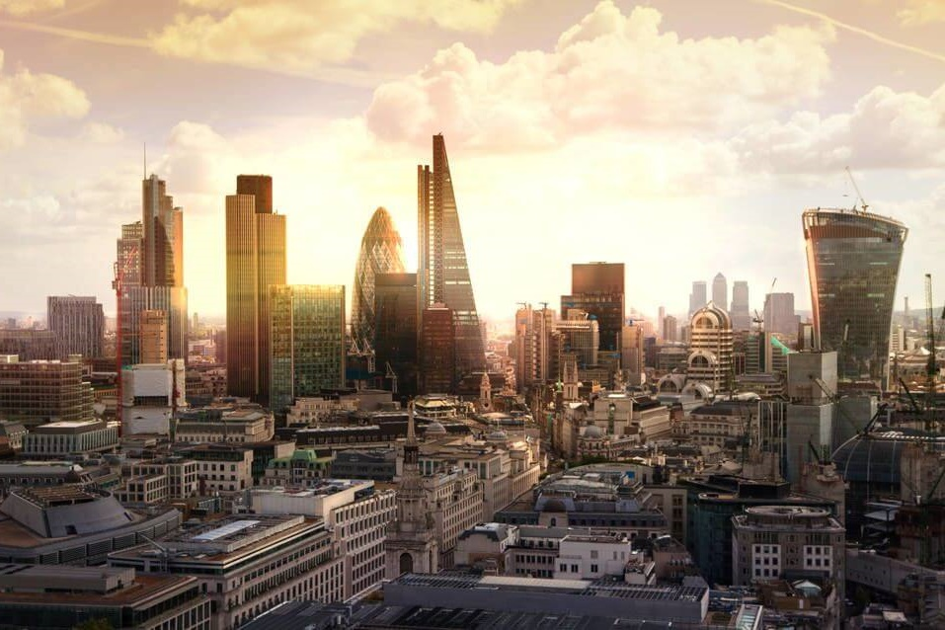


CPD - Glass for
Architecture and Facades
COPYRIGHT © 2020 NSG Group
Notes:
Good Morning/Afternoon, my name is ……………………and I'm here to deliver a CPD on Glass for Architecture and Facades.

Slide 4

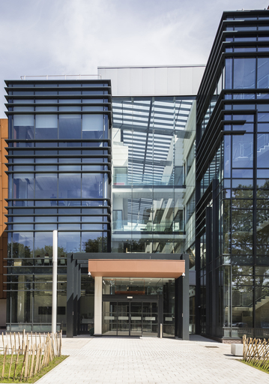
Contents
Pilkington / NSG Background
Float Glass Manufacture
  Method
  Sustainability
  Characteristics
Energy Management
  Thermal insulation
  Solar control
Point-fixed Glazing Systems
Fire-resistance
Self-cleaning Glass
Questions
The Materials Innovation Factory by Fairhurst Design Group
Notes:
[The Materials Innovation Factory, Liverpool [Architects: Fairhurst Design Group]]
During this presentation we will touch on the following subjects:
I’ll begin with a brief introduction to the Pilkington NSG group.
I’ll then give you an introduction to flat glass; the sustainability of glass; and the characteristics of glass
We will then be covering the four different categories of glass used in architecture: Glass for Energy Management; Fixed-point Glazing Systems; Glass for Fire-resistance; and Self-cleaning Glass.
During the presentation we will indicate various examples of the use of glass within architecture identifying the project name and architect involved. There should be time for questions at the end of the presentation, but feel free to ask any questions throughout.

Slide 5

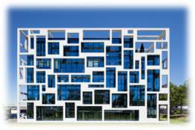
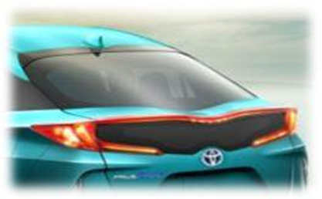
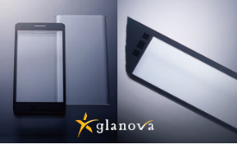
Pilkington UK / NSG Background
Architectural: 40%
Supplies glass for new and refurbished buildings and for Solar Energy applications.
Automotive：50%
Serves the original equipment, aftermarket replacement and specialized transport glazing.
Technical： 10%
Products include very thin glass for displays, lenses and light guides for printers, and glass fibre, used in battery separators and engine timing belts.
Mission
Background
NSG acquired the leading UK-based glass manufacturer Pilkington plc in June 2006. Today, the Company has combined sales of JPY 612 billion (circa 4.0 Billion GBP), with manufacturing operations in roughly 30 countries and sales in 130 countries, employing some 27,000 people worldwide.
Sir Alastair Pilkington invented the Float glass process in 1952, now the world standard for high quality flat glass manufacture.
Changing
our surroundings, improving our world
Aspiration
Core Values
Through innovation, becoming the most trusted partner
in all industries
we work in
Respect others and unleash
their potential
Exemplify trust and integrity
Ensure efforts to serve society
Take the initiative
Embrace challenges and learn from failure
Follow through to get results
Notes:
First, let me give you some background information to set the scene.
Founded in 1826 and a member of NSG group since June 2006, Pilkington is one of the world's largest manufacturers of glass and glazing products.
Combined annual sales of NSG/Pilkington are circa £4.0 billion.
It has manufacturing operations in roughly 30 countries with more than 27,000 employees worldwide and sales in 130 countries.
Sir Alastair Pilkington invented the Float glass process in 1952, which is now the world standard for high quality flat glass manufacture.
(Read through the mission statement and explain the SBU’s)

Slide 6
Float Glass
Sand, soda ash,
limestone, salt-cake,
dolomite are melted
at 1600ºC
Poured into a bath of molten tin at 1100°C
Glass settles and is
pulled out at 600°C & annealed
Controlled atmosphere
Molten tin
Furnace
Float bath
Lehr
Notes:
The float process revolutionised glass manufacture by allowing the mass production of glass with exceptionally good visual quality in very large sheets – the typical “jumbo” size being 3210 mm x 6000 mm.
After being invented in 1952, it took a further 7 years and approx. £150 million in todays money to fully commercially develop and bring to market. (Approx. value using Bank of England inflation calculator)
At the start of the process, the raw materials are melted in a furnace at 1600°C. The liquid glass is then allowed to pour continuously onto a bath of molten tin. Molten glass floats on the surface of the tin and naturally forms a level ribbon with parallel faces about 6mm thick.
Float Production lines need to produce a range of thicknesses from approx. 1 mm thick up to 19 mm. To control the glass thickness, so-called top rollers are used which are positioned vertical to the glass surface at either side of the float bath. They can be used to pull or push the glass at the edge of the float bath by changing their angle. Pulling the glass through from the furnace more quickly makes it thinner, slowing the rate of flow makes it thicker. The glass then proceeds down the cooling line, at the end of which it is washed, inspected, cut and packed for automated distribution.

Slide 7
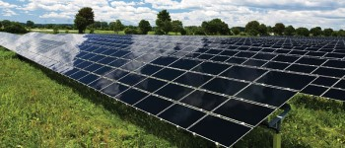
Sustainability of glass
  Glass can be recycled over and over again
  ‘Cullet’ (recycled glass) used as raw material in glass manufacturing
  As it requires less energy to melt, it contributes to reducing energy consumption and CO₂ emissions
  Forms 26% of the input raw materials that go into European flat glass furnaces
  EU flat glass sector has reduced its CO₂ emissions by 43% per output between 1990 and today
  CO₂ emitted to produce high performance double glazing unit is offset within 6 to 20 months by its energy savings
  Key component of renewable energy
  technologies such as photovoltaic panels on
  roofs and transparent Building Integrated
  Photovoltaics (BIPV)
Notes:
If adequately segregated, glass can be recycled an infinite number of times. Recycled glass, or cullet, is the glassmaker’s most valuable raw material. It replaces virgin raw materials, does not decompose to emit carbon, melts at a lower temperature than virgin materials, reduces air emissions and diverts waste from landfill. Using approximately 10% of cullet in the batch can reduce fuel consumption by 3%.
Continuous improvement and innovation have seen the EU flat glass industry reduce its CO₂ emissions per tonne of glass by 43% between 1990 and today. This has been achieved through better furnace design, construction and operation, increasing the share of cullet as a raw material and evolution in the energy mix, for example by phasing out oil-fired plants.
Research has shown that the CO₂ emissions associated with the manufacture of high-performance double-glazing units can be offset within 6 to 20 months of its use in buildings.
The contribution of flat glass to decarbonisation is not limited to energy savings, it is an indispensable material to produce solar energy as a key component of photovoltaic panels or as a substrate for the integration of transparent photovoltaic cells in buildings (BIPV). The latter is a fast-increasing market expected to progress.

Slide 8
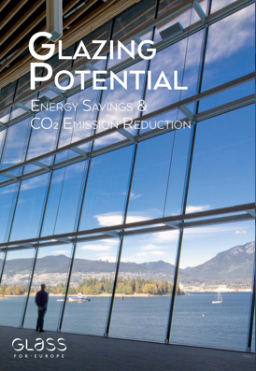
Energy savings potential of glass
Potential energy savings and CO₂ emissions avoidance that could be achieved annually in 2030 if high-performance glazing were to be installed in all UK buildings;
Annual Energy Savings:
9715 ktoe
32% energy consumption
Annual CO₂ Avoidance:
14372 ktCO₂
32% CO₂ emissions
Nearly half of the maximum savings potential identified for 2030 could be realised in 10 years by doubling the window renovation rate with high-performance glazing.
48336 ktoe of total energy savings can be achieved by 2030 in UK.
Notes:
Commissioned by Glass for Europe, the European trade association of the flat glass sector, an independent study undertaken by TNO quantified the potential energy savings and carbon dioxide reductions that could be realised if high performance glazing were to be installed in all of Europe's buildings.
The study found that, if all buildings in the UK were installed with high performance glazing, 9715 ktoe (kilo tonnes of oil equivalent) energy could be saved annually by 2030, with a corresponding avoidance of carbon dioxide emissions of 32%.
Also, nearly half of the total savings potential identified for 2030 could be realised in 10 years by doubling the window renovation rate with high performance glazing.
A summary of the findings from the study can be downloaded from the Glass for Europe website.
[Note for presenter. 1 kilo tonne of oil equivalent is equal to 1.16 kWh]

Slide 9
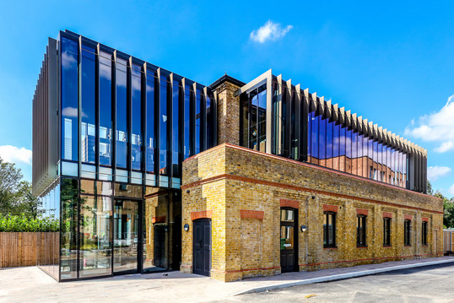
Float Glass Characteristics
  Fundamentally a strong, brittle, material
  Can be severely weakened by fine cracks & abrasions
  Usually found in the following forms:
  Annealed (inc. patterned/wired)
  Laminated (eg. PVB, Ionomer)
  Heat treated (eg. Toughened,
  heat strengthened, etc)
Hox Haus, Royal Holloway University of London by 74
Notes:
[Hox Haus, Royal Holloway University of London [Architects: 74]]
Reminding ourselves of the commonly-known characteristics of glass:
It is a strong material (if we look at the strength of the molecular bonds in glass it should be stronger than steel) but it can be weakened by cracks and abrasions, and this is the basis of cutting glass – we score the surface and snap or break the cut open along the score-line.
It behaves like a brittle substance (technically an amorphous solid) and is found in the following forms:
Annealed (inc. patterned/wired)
Laminated (eg. PVB, Ionomer)
Heat treated (eg. Toughened, Heat strengthened)
By processing and adapting one or more of these basic forms we can achieve a range of effects and properties.

Slide 10
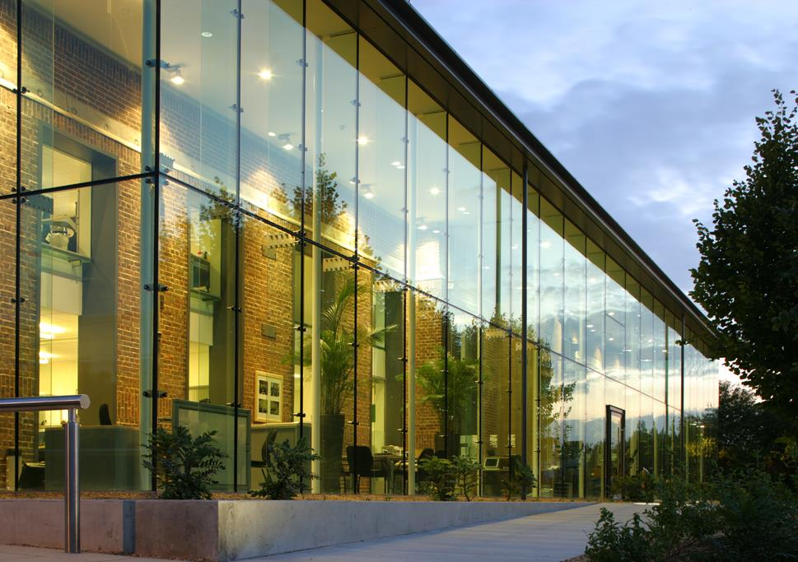

Glass for
Energy Management
Cambridge water company by BCR Infinity Architects
Notes:
[Cambridge water company, Cambridge [Architect: BCR infinity]
Energy Management is concerned with controlling the amount of heat that enters and leaves a building.
As one of the primary materials of the building envelope, the glazing needs to have insulating properties in order to help retain heat in cooler weather. We can also use the glazing to prevent excessive heat entering the building in warmer weather. By using glass in these ways, we can reduce the required cooling and heating of the building which uses relatively expensive plant and mechanical services.

Slide 11



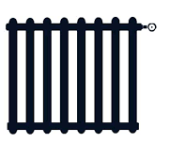
Thermal Insulation – Heat Loss
Outside
Inside
Convection, wind & rain
Convection
Conduction
Long wave radiation
exchange to skies
and surroundings.
Long wave radiation
exchange to inner surfaces.
Notes:
Heat loss from glass can be by the same processes as any material – by convection with heat dissipated by wind and rain, by conduction through the body of the glass, and by radiation from its surface. Despite this, it is possible to change glass’s insulating properties, beginning with its U-value.
U-value is the term that refers to how much heat passes through a material; the lower the number, the better the insulating material.

Slide 12

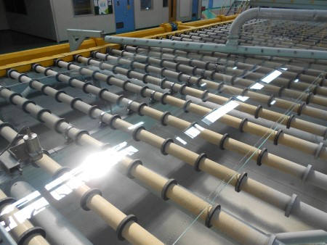
Single Glazing
Thermal Insulation
Single
e.g. Clear float glass
Thickness | U-Value (W/m²K)
4 mm | 5.8
6 mm | 5.7
10 mm | 5.6
Notes:
12
Raw glass is neither a particularly good nor a particularly bad insulating material and all glass manufacturers’ figures will be very similar.
As we can see here, making the glass more than twice as thick does very little to improve the U-value, improving by only 0.2 Watts per square metre Kelvin. This is a negligible improvement when you consider that we are aiming for a whole window U-value of no worse than 1.6 Watts per metre squared Kelvin in order to comply with Building Regulations. (Approved Document L1B)

Slide 13


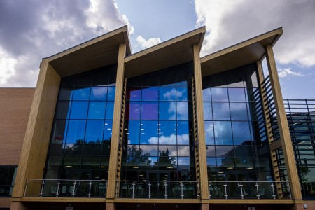
Reducing Heat Loss
Thermal Insulation
Double
Insulating Glass Unit
Cavity | U-Value (W/m²K)
6 mm single | 5.7
6 mm air | 3.3
12 mm air | 2.9
16 mm air | 2.7
16 mm argon | 2.6
Slimming World HQ by CPMG
Notes:
[Slimming World Headquarters, Alfreton [Architect: CPMG]]
The invention of double-glazing entailed introducing a second glass pane in order to trap a layer of air as a visually unobtrusive, and readily available, insulator.
The distance between the panes would ideally be 16mm wide. We can see from these figures how the U-value reduces by nearly 20% simply by widening the air gap a mere 10mm from 6mm to 16mm. The use of an inert gas such as argon can further lower the glazing unit’s U-value by about another 0.1 Watts per metre squared Kelvin.

Slide 14
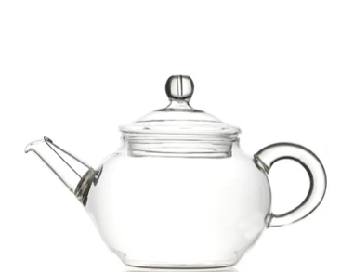
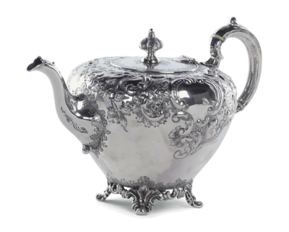
Thermal Insulation - Emissivity
Which teapot do you think would retain tea’s heat better?
Notes:
To markedly improve the insulating qualities of glazing we need to alter one of the basic characteristics of glass itself, the way in which it emits heat.
It might initially seem a strange idea to make tea and coffee pots out of solid silver or with silver plate. Being metal, the silver should simply conduct the heat from the warm interior to the outside environment, allowing the tea or coffee to quickly lose its heat. However, this is only true up to a point.
The warmth of the beverage is indeed conducted away from the inside of the pot – the surface is warm to the touch – but silver has difficulty with losing heat to the environment. We say it has a poor emissivity.
Glass on the other hand is quite a good emitter of heat, losing heat readily to the environment once it has been conducted through the body of the glass.
We could thus improve the insulation qualities of glass by changing a characteristic of its surface, its emissivity, to more like that of silver, and we can do this by coating the surface of the glass with a microscopically-thin silver-based metal compound.

Slide 15
Manufacture of on-line coated glass
Coating beam sprays gasses onto glass surface as it moves through tin bath
Furnace 1600 ºC
Tin bath 1050 ºC
Annealing lehr 620 – 250 ºC
Notes:
On-line coated products are applied during the float glass manufacturing process and are more durable and less susceptible to damage during the processing stage, compared to off-line coating which will be discussed on the next slide. They also have a longer storage life pre manufacture into insulating glazing units (IGU’s).
These coatings are extremely versatile and can meet current building regulations, but for better thermal performance we need to look at a slightly different technology.

Slide 16
Manufacture of off-line coated glass
“Sputtered” Coatings Schematic of Magnetron-sputtered Coating Plant
Power Supply
Vacuum
Pump
Pump
Coating Electrode
Ambient temperature
Atoms of material ejected by the bombardment of positive ions
Target Material
Ar⁺
e⁻
Ar⁺
e⁻
e⁻
Plasma
Rollers
More chambers
Semi-continuous Process
More chambers
Notes:
The move from on-line to a separate process after glass manufacture, often referred to as off-line coatings, are better performing thermally but require a more careful approach from a processing perspective as its easier to damage the coating if not handled correctly.
Capacity
The line has a capacity in excess of 10M m² /year
Line speed of up to 11 m/min
(If queried, line speed figure doesn’t take area of glass into account, so capacity isn’t line speed x minutes in a year)
Special features
Latest design from a world leading coater manufacturer.
Includes a wide variety of advanced process control and monitoring systems
Working pressures
After cleaning the machine, we pump the air out of the coater to reach a base pressure of less 2 x 10-6 mbar (approximately a billionth of atmospheric pressure).
After pumping down to our base pressure, we then feed in mixtures of argon, oxygen and nitrogen so that the pressure increases to about 3 x 10-6 mbar (approximately a millionth of atmospheric pressure). This is our working pressure
The pressures we work at are like that outside of a space shuttle when it is in orbit.
The pressure difference between inside and outside means that there is roughly 10 tons of load on every square meter of the main chamber
Sputtering and materials
We remove material from targets by sputtering. By mixing this material with either oxygen or nitrogen, we can make the coatings we require.
The lifetime of targets varies from ~ 2 weeks to more than a year depending on the material.
This facility can produce coatings that are uniform from plate to plate, campaign to campaign, year to year.

Slide 17
Thickness of off-line coatings
Coatings are typically 80 to 200 nanometres thick
  Can comprise of > 10 layers
By comparison, a piece of paper is about 100 micrometres thick
Our coatings are ~1000 times thinner than a piece of paper!
Hair
~70 μm
The thickness of a piece of paper
An off-line coating
Notes:
The coatings we make are typically 100 nanometres thick and made up of more than 10 different layers of a range of materials. That thickness is 1000 times thinner than a piece of A4 paper. The coatings are made from multiple layers, some of which may only be 1 or 2 nanometres thick.
To give you an idea of the thickness we compared this to a human hair and paper.

Slide 18
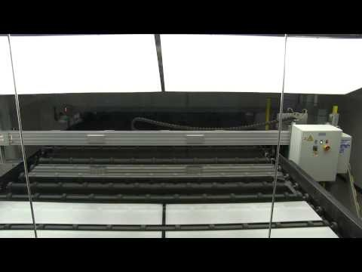
Off-Line Coating Equipment
Notes:
(Click) For a more visual description, here is a short video on how the off-line coater works.

Slide 19
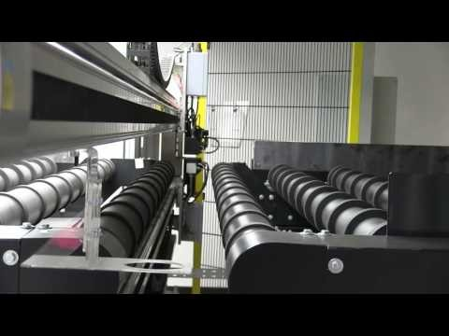
Off-Line Coating Equipment
Notes:
(Click) And here is a quick look at the coater through the different processes.

Slide 20
Thermal Insulation - Emissivity
Glass type | Emissivity
Annealed float glass | 0.89
On-line coated | 0.14
Off-line coated | 0.01
Notes:
The whole range of emissivity values is between 0 and 1, with 0 being the theoretical minimum of a perfect insulator.
Raw glass has an emissivity of 0.89, which is quite high compared with the theoretical maximum of 1.
However, by applying a specific coating we can reduce the glass’s natural emissivity and make, for example, a hard-coat with a normal emissivity of 0.14. We can also apply other, better performing coatings to achieve emissivities as low as 0.01.
Low emissivity (low-e) glass is glass which has an emissivity of 0.2 or lower.

Slide 21
Thermal Insulation - How low-e glass works…
Long Wave Energy
Short Wave
Energy
Notes:
So how do these coatings work in double-glazing?
Radiation from the sun is in the form of high-energy short-wave radiation which the coating allows to pass through into the room. After being absorbed by items in the room such as carpets, furniture etc it is re-radiated again but this time as low-energy long-wave radiation. It is this long-wave energy that the coating blocks, reflecting the heat back into the room. Similarly, heating systems produce long-wave heat energy as do lights, computers and machinery and even people. A proportion of all this heat is retained within the room by the glass and its coating. In fact, a double-glazing unit with a coated glass can be as thermally efficient as uncoated triple glazing.

Slide 22


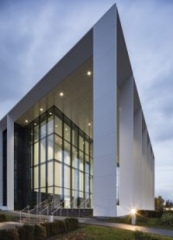
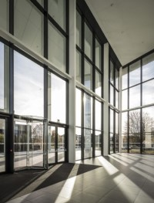
Thermal Insulation - Insulating Glass Units
Double
with
Low-e
e.g. 4 mm clear float glass
+ 4 mm on-line low-e
e.g. 4 mm clear float glass
+ 4 mm standard off-line low-e
Cavity | U-Value (W/m²K)
12 mm air | 1.6
16 mm air | 1.4
16 mm argon | 1.2
Cavity | U-Value (W/m²K)
12 mm air | 1.9
16 mm air | 1.7
16 mm argon | 1.5
234 Bath Road by Flanagan Lawrence Ltd
Notes:
[234 Bath Road, Slough. [Architect: Flanagan Lawrence Ltd]]
A double-glazing unit with a 16mm air-filled cavity, one pane of clear float and one pane of a on-line coated low-e glass will achieve a U-value at its centre of 1.7 Watts per square metre Kelvin, reducing to 1.5 if we replace the air-fill with argon.
For comparison, if the on-line coating was swapped with a standard off-line coated low-e pane the 16 mm air filled unit would achieve a U-value at its centre of 1.4 Watts per square metre Kelvin, reducing to 1.2 if we replace the sir-fill with argon.

Slide 23
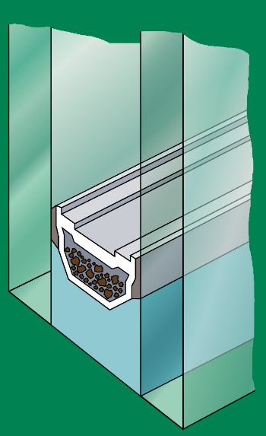
Thermal Insulation - Insulating Glass Units
Glass
Optimised cavity width
Gas-filled
Reduced emissivity
Insulating air layer(s)
e.g. triple glazing
Warm-edge spacer bar
Aluminium
Spacer Bar
Butyl
Desiccant
Secondary Seal
Notes:
On a final point, as aluminium is a good conductor of heat, there have been efforts by cavity-spacer-bar manufacturers to reduce unit edge losses by making the cavity spacer bars out of better insulating materials such as stainless steel or plastics. In a series of heat-loss tests on an average-sized window by the National Physics Laboratory, the U-value was generally reduced by around 0.1 W/m²K using these alternative bar materials.
As we have seen, this scale of reduction in U-value does not compare with that achieved by low-e coatings but it might be important if the framing material is not efficient enough and the glazed aperture is still just outside the regulatory requirement even with its low-e coating and gas-fill.

Slide 24

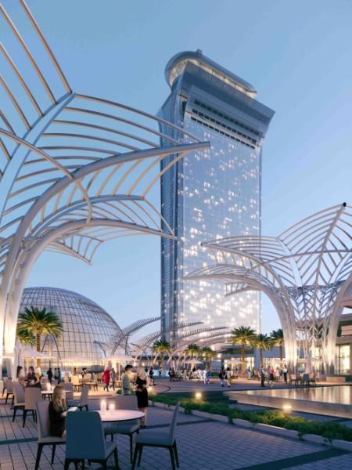
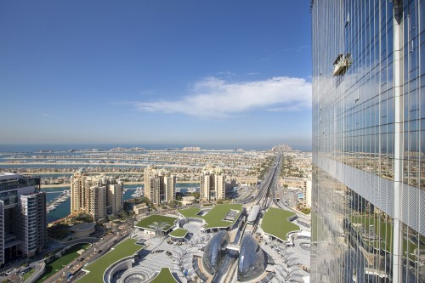
Palm Tower, Dubai
Palm Tower, Dubai
Notes:
[Palm Tower, Dubai]
Now on to solar control – With increasing areas of glazing in buildings, even comparatively mild summer weather can raise the possibility of untenable interior environments. Managed ventilation and the careful selection of solar control glass are frequently required to control heat levels within the building.
Early solar control glass was simply dark glass, blocking the sun’s light as well as its heat. However there seems to be little point in using glass at all if it is required to be so dark as to be difficult to see through. Fortunately, technology has improved to the point where we can offer several clear and neutral coatings as well as a range of colours.
All our published performance data, of course, adheres to the relevant European standard EN 410 : 2011: Glass in building - The Determination of Luminous and Solar Characteristics of Glazing.

Slide 25
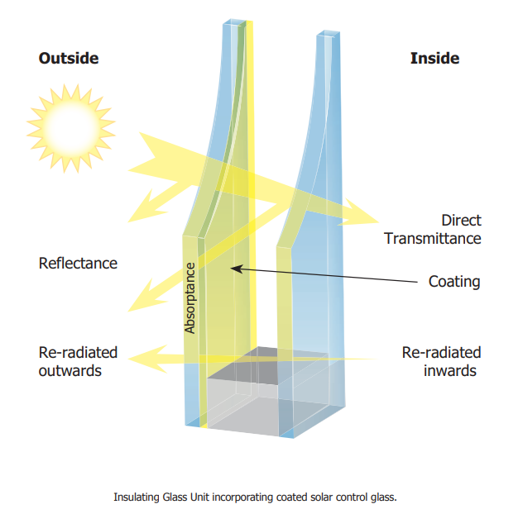
Solar Control ‒ Terms & Codes
Notes:
So, for buildings with a large expanse of glass, for example on some retail or commercial projects, we need to consider the effects of solar heat gain. This is how much of the sun’s energy enters the building and thus can cause overheating.
There are many products that perform in slightly different ways as the characteristics of each will determine how much heat is reflected, absorbed or directly transmitted.
Total Solar Heat Transmission (TSHT) ie Direct + Re-radiated, is now referred to as g-value and is calculated in accordance with the European standard EN 410: 2011.
So, tinted glass can absorb the heat but a more efficient way is to use a high performance off-line solar control and thermal coating that can deal with solar radiation.

Slide 26
Solar Control ‒ Performance
70/35
Light Transmission (LT)
Solar gain
Notes:
There are numerous solar control coatings available and the selection is driven by the aesthetics and performance required following the modelling of the building.
Coatings are generally described by being given two numbers, for example 70/35. Typically, the first figure is the Light Transmission (LT) and the second is the solar gain. So in this example 70% of the light is passing through the glass with the coating and 35% of the solar heat is passing through. Generally the higher the first number and the lower the second number the better because this means optimal daylight is still being let into a building but without the heat.

Slide 27
Solar Control ‒ Solar Spectrum
UV
Visible
IR
100
Relative Intensity
50
0
0
500
1000
1500
2000
2500
Wavelength (nm)
Notes:
This slide illustrates the central conflict between control of solar transmission and high light transmission.
The sun emits energy in the form of electro-magnetic radiation, most of which our bodies can interpret as heat but only some of it as light.
The graph represents the full spectrum of this solar radiation with ultra-violet wavelengths to the left and infra-red to the right. The yellow band represents the light wavelengths that are visible to the human eye.
When we are developing coatings to reduce solar radiation, that is, heat transmission, we first reduce the UV and infra-red wavelengths as these wavelengths are invisible to human beings anyway. Having accomplished this, if we then require any further reduction in heat transmission, we then have to reduce the wavelengths of the spectrum that are visible to us. In other words, make the glass darker.
Therefore, there are diminishing returns in terms of light transmission in stronger solar control glasses.
It is worth bearing in mind how “clever” our eyes are. A glazing unit with, say, a 50% light transmission may sound quite dark but because our pupils naturally open when inside a building, any noticeable reduction in the internal light will be markedly off-set. If in doubt as to the appearance of a coating, please request a sample and then view in-situ from both inside and outside the proposed application if possible.

Slide 28
Typical g-values for different ‘coloured’ glass
g-value | Colour/tint
0.18 – 0.45 | Clear/Neutral
0.20 – 0.46 | Blue
0.31 | Silver
0.31 | Grey
0.32 – 0.53 | Bronze
0.36 – 0.43 | Green
Notes:
When looking at different coatings and their performance, there are plenty of options on the market. Because of the materials used in coatings, the appearance of the glass can be slightly changed after coating are applied. For example, a coating can make a sheet of glass look blue.
Here are some of the typical colours/tints which glass can appear and the range of g-values which they could achieve.

Slide 29
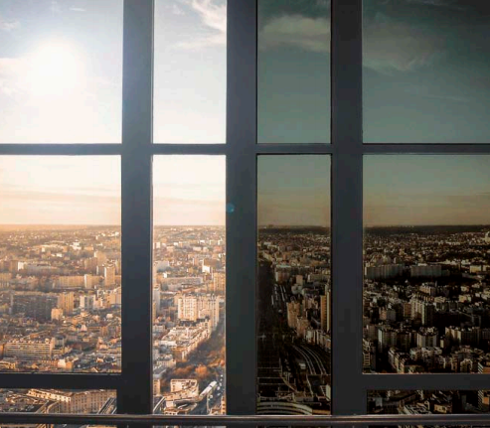
Solar Control ‒ Performance
Notes:
The next step in the technology is now moving towards intelligent glass that can change is solar properties throughout the seasons. A high light transmission on cold days giving passive heating, and then the glass darkens on warm days to protect against solar heat gain.

Slide 30
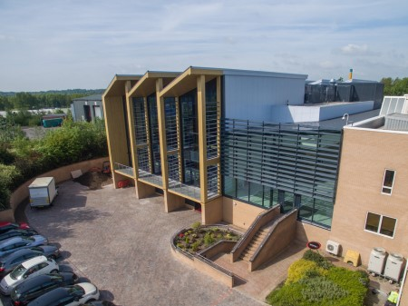
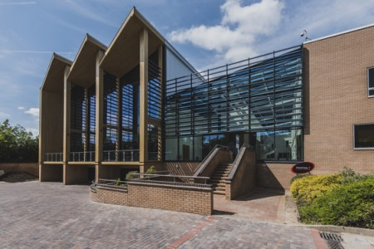
Slimming World Headquarters, Alfreton
Notes:
Project: Slimming World headquarters
Client: Slimming World
Main contractor: Morgan Sindall Construction
Architect: CPMG
With its newly extended headquarters in Alfreton, Derbyshire, weight-loss organisation Slimming World wanted to create a landmark building for the brand that would both provide an ideal working and training space for its people and deliver excellent environmental performance.
Glazing plays a key role in the £8.5 million scheme, both aesthetically and in terms of its use of energy.
At the heart of the building is a large atrium with a full-height glass front elevation and a glazed roof running right to the back of the space. Meanwhile, one of the wings connected by the lobby area features large ‘picture windows’ that deliver views over the facility’s attractive, leafy grounds.
High-performance envelope
Because much of the building’s envelope is glazed, the designers faced the challenge of avoiding the need for an energy-intensive climate-control system to create a comfortable environment for users all-year-round.
The curtain walling system uses double-glazed units containing solar-control and thermally efficient coated glass.
The solar-control glass features a state-of-the-art coating that transmits only 31 per cent of the sun’s energy, while still allowing for 60 per cent light transmittance, so that occupants still get a clear view outward.
The low-emissivity glass meanwhile features a coating that reduces outward radiation of heat, so that less is allowed to leave the building on colder days.
Uninterrupted views
The same glass is used in the atrium wall and roof, but is held in place using the latest structurally glazed units. These deliver glazed surfaces with ultra-low-profile frames to minimise interruption of views from the building, as well as daylight flowing into it.
Extra strength is added to the atrium glazing by including a layer of laminated glass on the inner pane, to help the large units stand up to forces exerted on them by the wind and potentially the weight of snow during the winter.

Slide 31
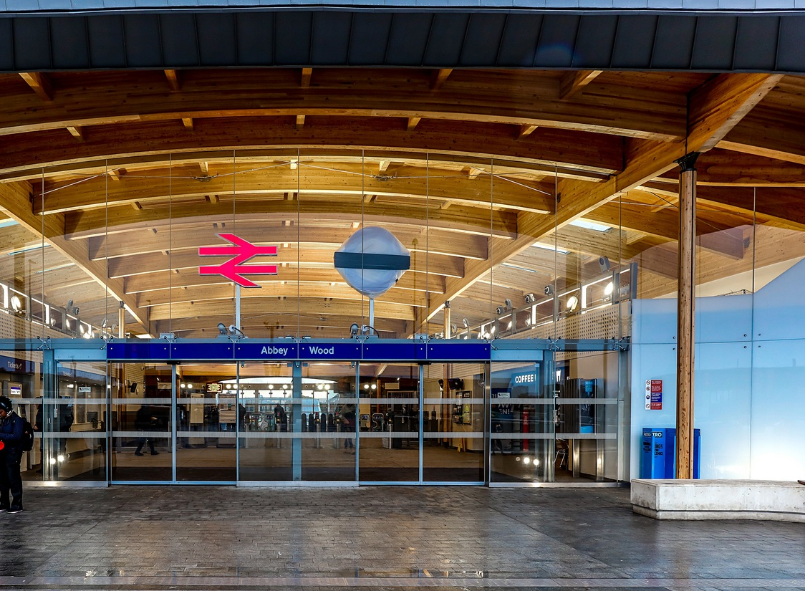
Fixed-point Glazing systems
Abbey Wood Station, London
by Fereday Pollard Architects Ltd
XX July 2019
Meeting Name
Notes:
[Abbey Wood Station, London [Architect: Fereday Pollard Architects Ltd]]
Moving on to the second category of architectural glass, point-fixed (i.e. frameless) structural glazing.
The introduction of point-fixed structural glazing offered the world a revolutionary method of creating glass facades. For the first time, facades could be erected without the need for intermediate support structures, allowing architects the freedom to design buildings with a greater degree of transparency.
The system is now designed and supplied worldwide, with a versatile range of glass, support & fitting technologies and a 12-year performance warranty

Slide 32

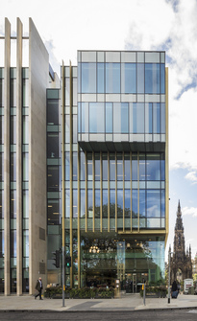
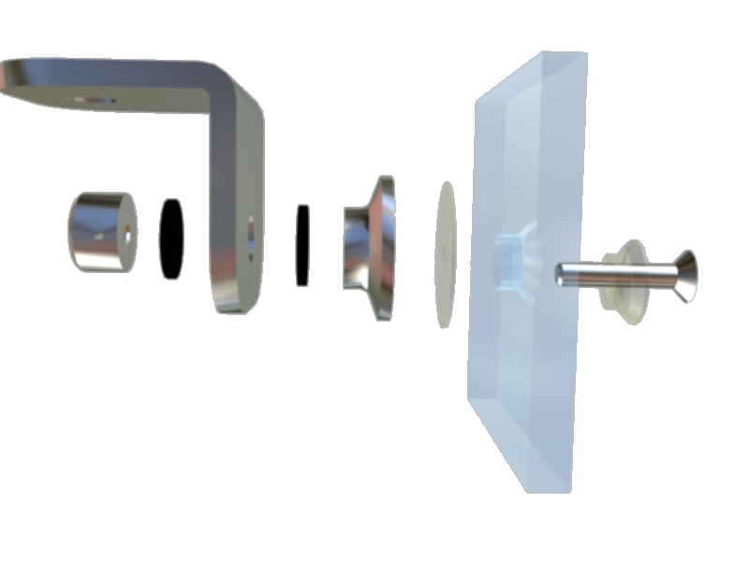
What is Point fixed Glazing?
A frameless glazing system
Specially engineered, toughened glass
Tested stainless steel fittings
Enables glass to be connected to glass, steel, aluminium and even timber via countersunk holes
Offers Building Designers various possibilities
6 St Andrews Square by CDA and Hoskins
Notes:
[6 St Andrews Square, Edinburgh [Architects: CDA and Hoskins]]
Typically point-fixed glazing is a frameless system connecting toughened glass and specially engineered and tested stainless steel fittings via holes in the glass without the need of a frame on all four edges. This can then be connected to another piece of glass or steel, aluminium or even timber.
The glass to glass joints are nominally 12mm in width and are weather sealed with silicone. The system has been independently tested using the Centre for Window and Cladding Technology (CWCT) Standard for Systemised Building Envelopes (2006), which test for air leakage, water penetration and wind resistance. The CWCT is recognised by industry for their leading work in the field of building envelopes and this standard is widely referenced in project specifications.
As with any structural glazing, compliance should be confirmed with the wind loading requirements of Approved Document A (in England) for the point fixed glazing system that has been specified, with wind loads determined in accordance with BS EN1991-1-4:2005+A1 2010.
Air leakage is also covered under EN 12153 :2000: Curtain walling - Air permeability - Test method
This gives building designers the ability to create dramatic glass facades, roofs, canopies or even clad whole buildings that have unobstructed views and stand out from the crowd.

Slide 33

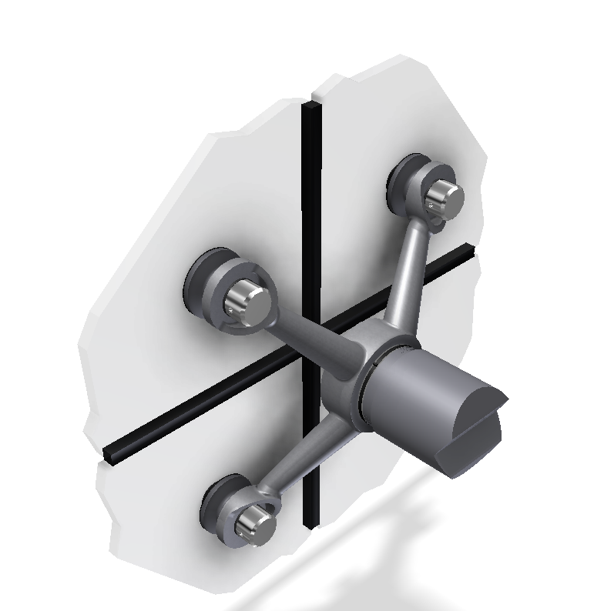
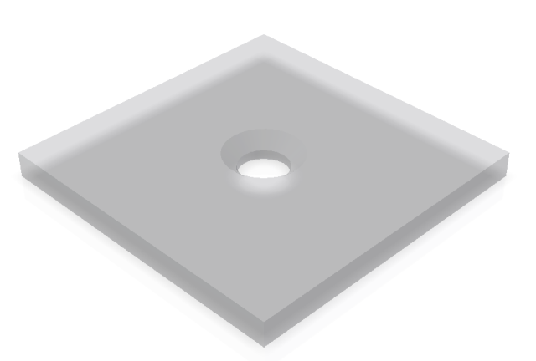
Design Principles
The countersunk hole through the glass has to transfer the load from wind, snow and self weight back to the supporting structure via the stainless steel fittings.
Standard slots & holes in fittings:
Typical Fitting Detail
9 x 18 mm slot
18 mm dia. hole
Countersunk hole in glass
Notes:
The Countersunk hole through the glass must transfer the load from wind, snow and self-weight back to the supporting structure via the stainless-steel fittings.
Typically, the dead-weight of the glass panels is taken at the top two corners (hung) by means of a horizontal slot in the connection fitting - all other holes in the stainless-steel fitting are oversize to allow for slight movement of structure which could arrive from temperature differential or live load.
It is also possible to “prop” the glass panels, i.e. take the dead weight on the bottom two holes.
The structure which the glass connects to whether it be glass fins or steelwork should be installed to a tolerance of +-5mm. The hole and slots are not there for structure or installation tolerance and glass should be allowed to float to minimise the stress in the glass.

Slide 34
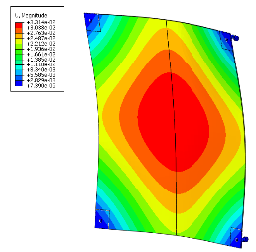
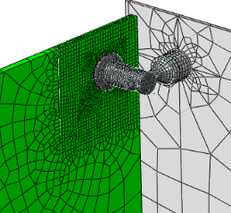
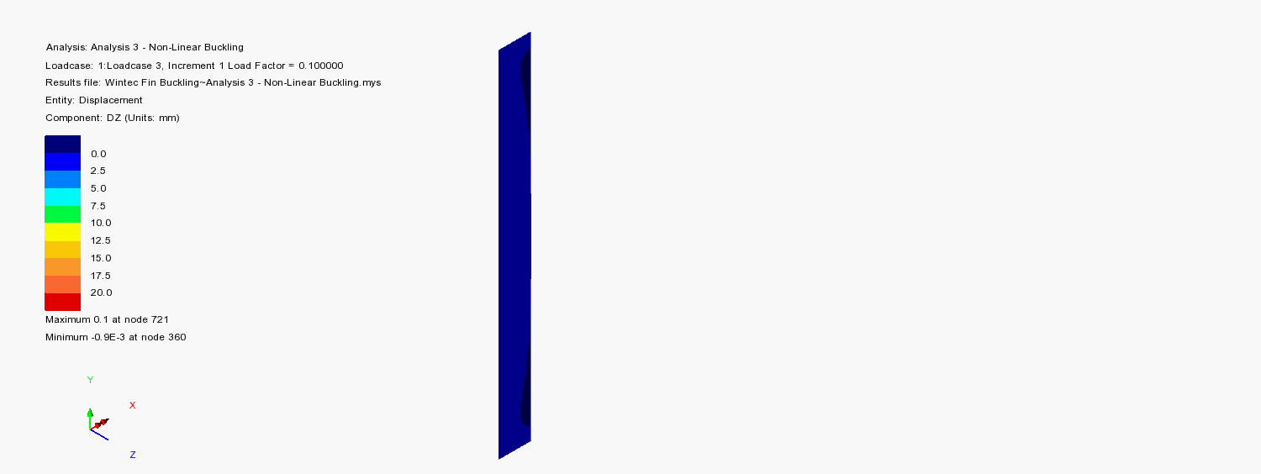
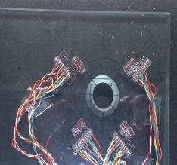
Design Principles
Finite Element Analysis (FEA)
FEA Simulation Video (Click)
Strain gauge analysis
Notes:
Engineers utilise Finite Element Analysis (FEA) to support the design of the system for both external glass, glass fins and associated fittings. The FEA is based upon real physical test data of the system.
The Strain Gauge tests allow the engineers to determine the stress around the bolt, and therefore the number of fixings required to minimise deflection in the panel at a given design wind load.
The video indicates a simulation of a glass fin buckling under wind load, the data would then be aligned back to a physical test.

Slide 35
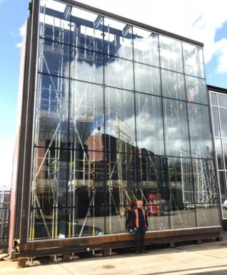
Point Fixed Glazing Advantages
Frameless
Reduced sight lines
  Highly attractive environments
  More light and a greater sense of space
Durability testing of the system to ensure long life expectancy
Resistant to 300 mph winds
Designed to minimise deflection
Specifiable for bomb blast, earthquakes & typhoons
Wintech Engineering Ltd, Telford April 2018
Notes:
This system’s great strength is its versatility, allowing glass to be used in a wide variety of planes, not just vertically, and glass walls are possible without the requirement for metal mullions.
It is even possible for us to design for some of the world’s most weather-torn countries – we can design a frameless glass façade that can withstand earthquakes and typhoons – or even a bomb-blast.

Slide 36
System Capabilities - Glass
SINGLE GLAZED
SINGLE GLAZED LAMINATE
SINGLE GLAZED INTEGRAL
DOUBLE GLAZED UNITS
DOUBLE GLAZED LAMINATED
TRIPLE GLAZED UNITS
Notes:
Versatility
Available Single Glazed, Double Glazed, Triple Glazed, with the full range of performance products to control the environment. The structural glazing system can be designed to help meet the requirements of Building Regulations Approved document L2A and L2B for conservation of fuel and power.
Durability
12 Year Warranty glass has been used in buildings for centuries, stainless steel and silicone with 25-30-year life expectancy.
Low Maintenance
Maintenance manual issued as to cleaning procedures and requirements for checking tightness of bolts and silicone stability.
Aesthetics
Flush, clean minimalist choice of glass type, colour, reflective coatings and variety of support structures.
Weatherability
Fully sealed (not drained) system, zero air and water penetration @ 600 Pascals.
Customisation
Can be glazed in any place, various alternative support structures, customised castings, decoration from silk screen prints, acid etching, sandblasting.
Confidence
Installed by Independent Accredited Network of Installers who are regularly trained, offering a 12-year warranty.

Slide 37
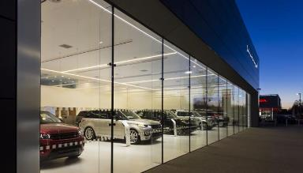
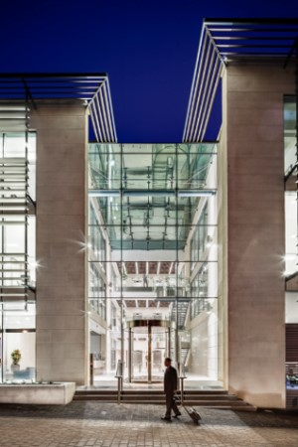
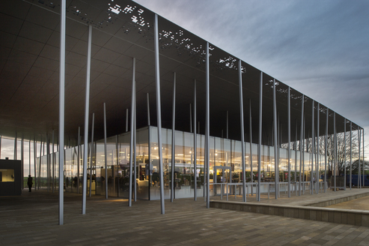
Typical Point-fixed Applications
Range Rover Showroom, Erdington
by MDG Architects Warwickshire
Stonehenge Visitors’ Centre by Denton Corker Marshall
St James’ Place, Cirencester
by Scott Brownrigg
Notes:
[Clockwise from top-left: Range Rover, Erdington [Architect: MDG Architects Warwickshire] St James’ Place, Cirencester [Architect: Scott Brownrigg]]
Structural glazing can be connected to several types of support from simple angle steel to complex trusses and tension structures and used in a wide range of construction situations.
In toughened form, entrances, shop fronts, screens and links provide light and vision, and in overhead applications laminated glass brings safety and security as well as acoustic benefits.
But always, the use of glass mullions allows free areas of glazing without the need for solid structures and external framing members, allowing more natural light to enter open spaces.

Slide 38
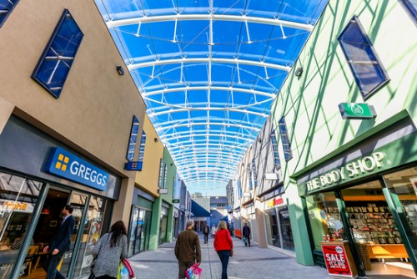
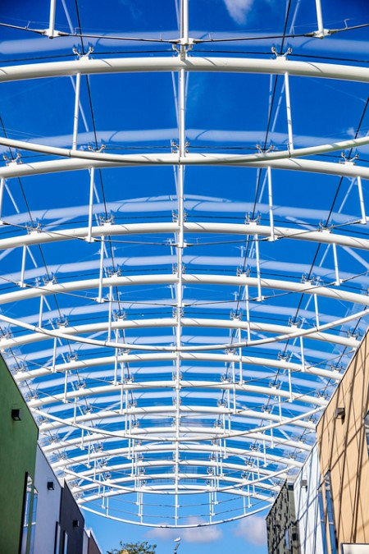
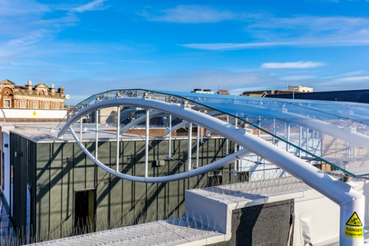
Market Walk, Newton Abbot
Notes:
Project: Market Walk Newton Abbot
Client: Teignbridge District Council
General contractor: Classic Builders
Architect: LHC Group
“Weather has had a greater effect on sales than economic numbers, we’ve known that forever”. So said former John Lewis managing director Andy Street, alluding to a longstanding challenge for British retailers – how to keep shoppers coming out on cold, wet and windy days.
At one traditional shopping centre at the heart of a Devon town, the solution is architectural – enclosing the previously open-air pedestrianised street with a large glass roof in order to create a space that can be enjoyed all-year-round.
Originally built in the 1970s, the Market Walk shopping centre in Newton Abbot, South Devon, was bought by Teignbridge District Council in 2016.
The £13 million acquisition of Newton Abbot’s Market Walk shopping centre was the largest investment in Teignbridge‘s history and gave Teignbridge a greater ability to positively influence the future development of Newton Abbot’s central shopping district as well as regular and reliable source of income.
Teignbridge later invested £2 million in upgrading the centre and modernising the appearance of the busy retail centre.
Devised by architects LHC group, the project involved a comprehensive upgrade of shopfronts and paving, including re-cladding units and installing new furniture to create a more modern, welcoming street-scene. But, the defining feature is the barrel-vaulted roof, which will flood the space with light while protecting it from the elements.
Maximum clarity
A key part of delivering the architect’s vision for the scheme was constructing a roof that obstructed the view of the sky as little as possible.
This was achieved using a discreet steel structure of tension-chord-supported arched beams, holding structural glass units which are attached to the spans with the system’s stainless steel fixings.
The 4-point stainless steel Nexus castings allow the units to be anchored to the steel beams at the corner intersections by single bolts, minimising the hardware required and delivering a more unobstructed outlook.
The glass itself also contributes to the clarity, with true low-iron glass being used to deliver a sky view with the most natural colours possible.
A total of 475 sq m of laminated glass was used in the project, featuring 10mm and 6mm glass sandwiching a laminating interlayer. The canopy is almost the size of two tennis courts, and from the perspective of a visitor at street level, the span of the roof recedes behind the roofs of the shops, helping to maintain the original outdoor appearance.

Slide 39
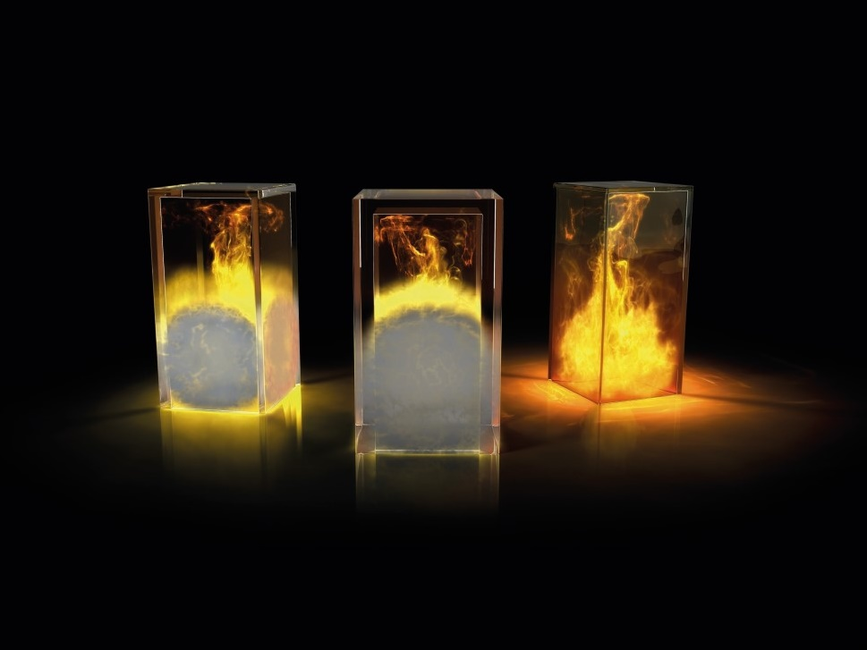
Glass for
Fire-resistance
Notes:
Now we will look at fire-resistant glazing.
Hearing a fire alarm is not a good time to question whether the right fire-resisting glass has been glazed or specified, but with the wide variety of products and performances available on the market, it is becoming increasingly easy to make serious errors.
The analogy that we make is that if the wrong coated glass is installed, the occupants of a building may be too hot or too cold for the prevailing weather conditions. If the wrong fire glass is installed then people‘s safety and even lives may be at risk.

Slide 40

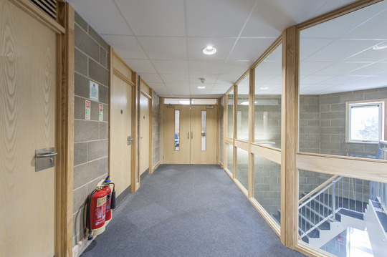
Fire-resistance Standards
Non load-bearing glazed elements to be tested British Standard (BS 476-22:1987) or European Standard (BS EN 1363-1:2020)
Two classifications of performance:
  Integrity
  Insulation
Fire performance ratings
in 15 minutes steps,
more generally 30
minute steps, often
specified by two figures
  e.g. 60/30 (60 mins integrity/
  30 mins insulation)
Lydia Eva Court Dementia Care Unit by Barron And Smith Architects
Notes:
40
[Lydia Eva Court Dementia Care Unit [Architects: Barron and Smith]]
The relevant standard for fire tests on non-load-bearing building materials and structures in the UK is either national standard BS 476-22:1987 or European standard BS EN 1363-1:2020. The important information to bear in mind is that there are 2 separate classifications, integrity and insulation which we’ll discuss in a minute, and that fire performance is rated in generally 30-minute increments in the format of a 2-figure number.
For example, a glass rated as 60/30 has achieved a minimum performance of 60 minutes integrity and 30 minutes insulation.
It is not possible for a fire-resistant glass to achieve an insulation rating higher than its integrity rating.
Available fire performance ratings: 30/0, 30/15, 30/20, 30/30, 60/30, 60/60, 90/90, 120/120

Slide 41
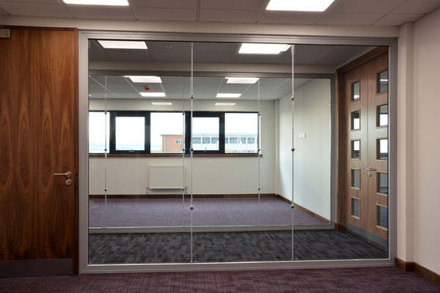
Definition of Integrity with Insulation
According to BS EN 1363-1: 2020
3.1.9 Insulation
“The ability of a test specimen of a separating element of building construction, when exposed to fire on one side, to restrict the temperature rise of the unexposed face to below specified levels”.
3.1.10 Integrity
“The ability of a test specimen of a
separating element of building
construction, when exposed to fire on
one side, to prevent the passage of
flames and hot gases through and to
prevent the occurrence of flames on the
unexposed side”.
Pets Choice by Barnfield Construction
Notes:
[Pets Choice, Blackburn [Installer: Barnfield Construction]]
Insulation
“The ability of a test specimen of a separating element of building construction, when exposed to fire on one side, to restrict the temperature rise of the unexposed face to below specified levels”
Integrity
“The ability of a test specimen of a separating element of building construction, when exposed to fire on one side, to prevent the passage of flames and hot gases through and to prevent the occurrence of flames on the unexposed side”

Slide 42
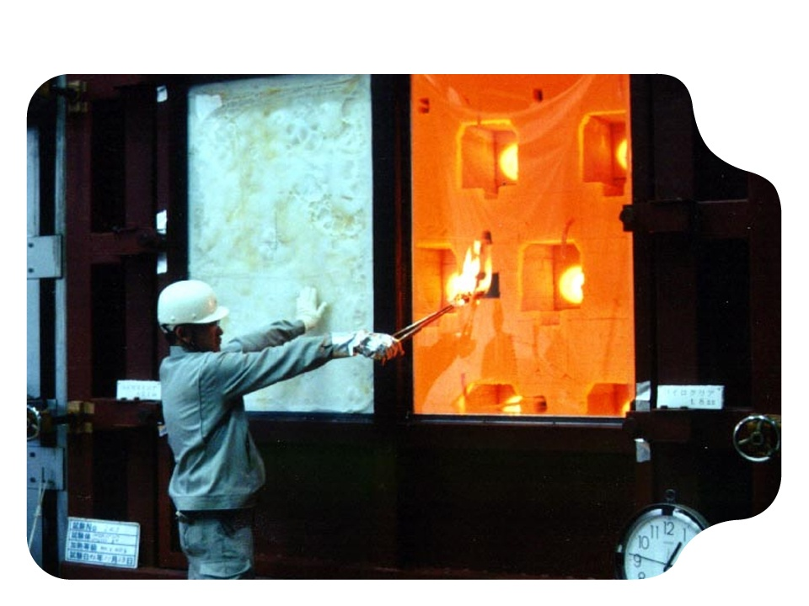
Integrity with Insulation
Insulation
+
Integrity
Integrity
only
Notes:
42
Look at this image for a visual representation of the difference between Integrity and Insulation.
Fire-resistant glass must only be used as part of a tested system. The glass and its specifically-designed framing system, together with the associated glazing materials and fixings to the surrounding structure, must jointly meet the regulations.
The test requires that as well as maintaining its fire integrity, the glazed screen must also limit the temperature rise on the safe side to no more than 140 degrees Celsius (plus ambient) on average and no more than 180 degrees Celsius (plus ambient) in a single so-called “hot-spot”. Fully insulating fire glasses generally build on established intumescent multi-laminate technology. The aim is to achieve insulation against the transmission of the fire heat radiation for 30 minutes and upwards, in 30-minute increments.

Slide 43
European Standards are more specific to type of glazed construction being tested
Standard | Application
EN 1363-1:2020 | General Requirements for fire resistance tests
EN 1364-1:2015 | Walls including glazing
EN 1634–1:2015 | Fire doors & walls including fire doors
EN 1365–1:2012 | Load bearing elements – Floors and Roofs
EN 13501–2:2016 | Classification document
E | Integrity
W | Radiation
I | Insulation
Always ask for fire test evidence!
Notes:
European Standards are already in force alongside UK national standard, these standards are more specific to the construction being tested.
The British Standard currently refers to the ability of the glass to act as a barrier to smoke and flames as Integrity. The European Norm (or EN) refers to this as the letter “E”. Similarly, where the BS refers to the controlled temperature rise on the non-fire side of the glazing as Insulation, the EN re-classifies this as the letter “I”. The definitions of Integrity and Insulation in BS and EN standards are very similar.
The EN standards have an additional classification of “W” which relates to a measure of radiated heat from the specimen. This is measured by a radiometer placed at 1m from the sample element and the heat radiation intensity is measured. This measurement is relative to element size – the body allowing passage / emitting the radiation.
The important point to note is that if the sample passes its Insulation test then it automatically passes the heat radiation and integrity tests.

Slide 44
Standard Temperature/Time Curve
BS EN 1363-1:2020 or BS 476-22:1987
Temperature (°C)
1,000
800
600
400
200
0
Standard time /
temperature
curve
Fire-resistant glass is exposed to
standard temperatures in a defined
time frame in a Standard Fire Test
0
10
20
30
40
50
60
Time (minutes)
Notes:
Testing is central to glazed fire protection, and testing of the whole system, glass, frame and glazing materials.
The ferocity and destructive power of fires vary enormously, governed by the fuels driving them. A petrochemical fire for example will reach a higher temperature more quickly than, say, an all-paper fire.
The British Standards Institute has constructed a time-temperature curve to represent what it considers to be an average fire, as represented here. The heating profile of any fire test furnace must achieve the relevant temperatures at the given times along the curve. In this way, all accredited furnaces will test all samples on a like-for-like basis, regardless of whether the test is carried out in the UK or somewhere else in the European Community for EN standards.

Slide 45
Fire – Resistant Glass for Insulation and/or Integrity
Temperature (°C)
1,000
800
600
400
200
0
Standard time / temperature
curve
Glazing which remains transparent
in case of fire – E30 & E60
Glazing which blocks radiant heat
as well as flames and smoke – EI30, EI60, EI90 etc
0
10
20
30
40
50
60
Time (minutes)
Notes:
Fire-resistant glass which remains transparent reduces the level of conductive and radiant heat, although the temperature on the safe side of the screen at 30 minutes is still approx. 550 degrees Celsius.
Glasses which contain intumescent interlayer materials can reduce this temperature whilst not being classified to an insulating time.
With an insulating glass, as well as keeping back flames, smoke and hot gases, the temperature on the safe side of the assembly will not rise by more than 140°C (plus ambient), regardless of the length of the test.
You can see here that at 60 minutes the glass is near 1,000°C, so these types of fire tests push glass to its physical limits.

Slide 46
Fire-resistance – Insulation
Multi-layer Intumescent Laminate Technology
On exposure to fire, intumescent silicate interlayers release water to form a glassy foam at only 120°C which is opaque to both heat and light.
Notes:
Let’s now look how these intumescent laminate glasses work in more detail.
(click) On exposure to fire, the heat will inevitably crack the 1st pane and pass through the glass to the first silicate interlayer. The interlayer contains water and as its temperature rises, the water boils away as the interlayer intumesces. This will now form a solid foam barrier thus blocking further passage of the heat. As the glass becomes opaque it has the added advantage of helping reduce panic as occupants exit the building.
Eventually this layer will be overcome as the ferocity of the fire increases and the layer chars. As the heat passes through to the next layer, the process begins again. Simply put, a greater number of intumescent layers will provide a longer period of protection from the flames and intense heat.

Slide 47
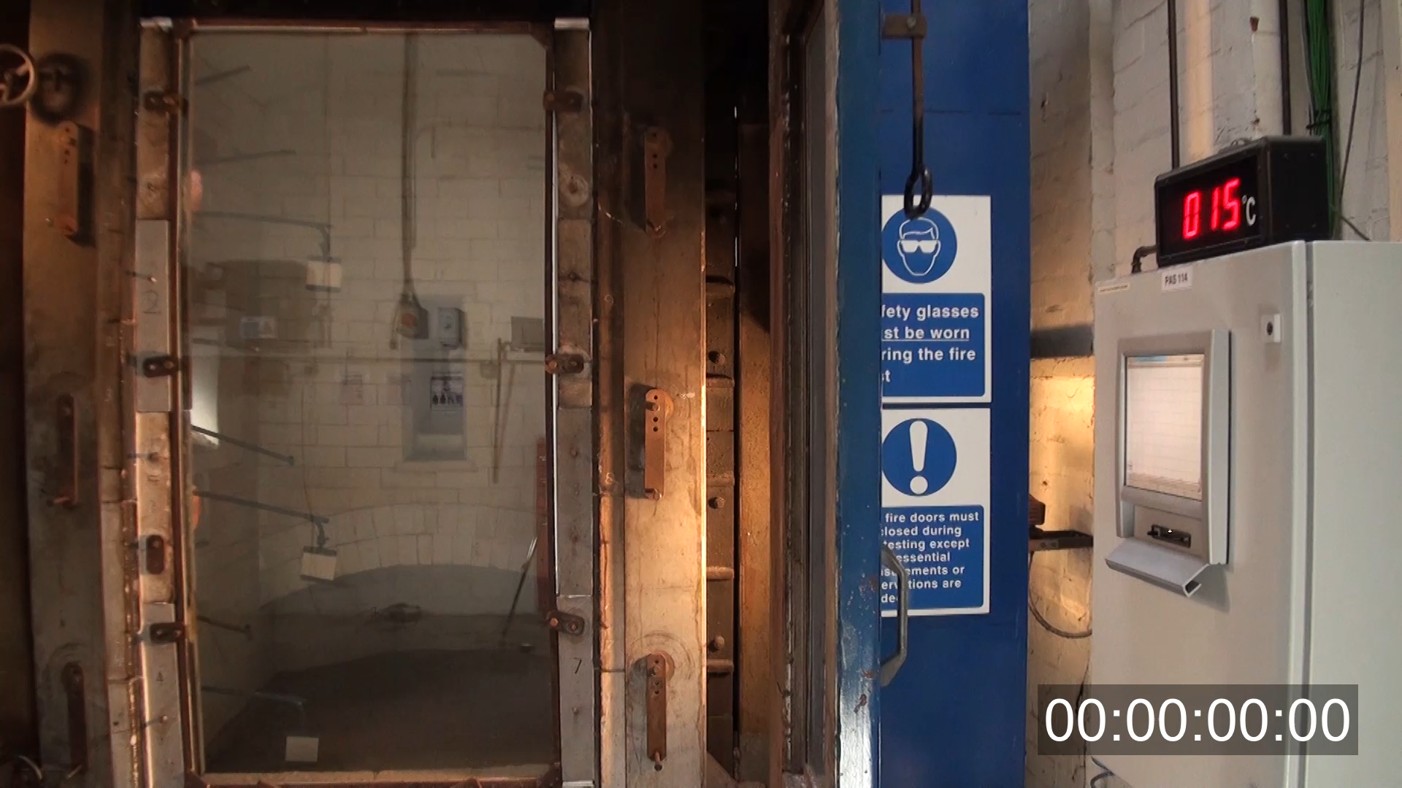
Notes:
We’ve seen the animation, lets see how quickly the furnace heats up and how quick the intumescent interlayers react. What appears to be a normal piece of glass on the face of it, shows how it would react in the event of a fire.

Slide 48
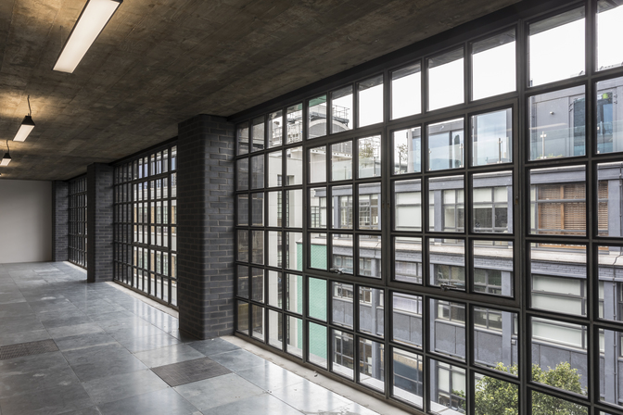
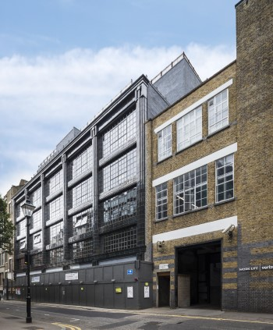
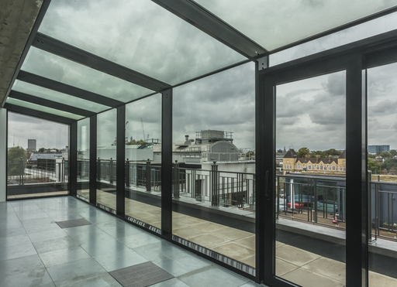
1 Aylesbury Street, London
Notes:
The increasing use of fire-resistant glass in public areas has enabled architects and designers to comply with ever-more stringent safety regulations without having to compromise on design aesthetics, allowing more light throughout the building and connecting the interior of the building with the world around it.
Multi-laminate fire-resisting products certainly help realise the architectural dream but always remember to ask for test evidence or assessments to back up manufacturers’ claims!
Project: 1 Aylesbury Street, Clerkenwell, London, EC1R 0DR
Client: Meritcape
Architect: Atum Design Lab
M&E consultant: EngDesign
Protecting Cities Against Fire With Advanced Glazing
Daylight-flooded spaces command a premium from tenants, but in the densest urban areas – where buildings are very tightly packed – it can be difficult to achieve. Not least because of the need to protect against the spread of fire.
This was the challenge for developer Meritcape when they set out to refurbish 1 Aylesbury Street – a converted historic warehouse building in Clerkenwell, East London.
The designers wanted to fill every floor of the building with natural light, from both the front and the back of the building by using floor-to-ceiling glazing on every floor. However, the rear of the property was just three metres away from a neighbouring building.
To prevent fire spreading from one building to the next, building regulations specify the fire resistance that external walls need to be able to provide. This is given as minimum requirements for integrity – how long they can contain smoke and flames – and insulation, or how long they can prevent the escape of heat.
The rear façade of the building is glazed in fire-resistant, insulating double-glazed units, delivering not only the right level of fire resistance, but have also been designed to give excellent thermal insulation (U-value) properties to reduce heat-loss from the building.
A total of 800m² of glass was used in the project, including in the front façade of the building, in which hundreds custom-sized small double-glazed solar-control units were used to imitate the crittall steel-framed windows that are a signature feature of buildings in the area.

Slide 49

Self-cleaning
Glass
Cheltenham Racecourse
by Roberts Limbrick Architects. Photo by Gary Britton
Notes:
[Cheltenham racecourse [Architect: Roberts Limbrick]]
This last section of the presentation will introduce you to a revolutionary product, self-cleaning glass.

Slide 50


Low Maintenance / Easy Clean
Proprietary coatings applied after IGU manufacture
Limited lifespan
  Manufacturers recommend re-applying after a few years
Health and Safety issues regarding application of coating
Can be applied to a wide range of glass
Notes:
It has been possible for some time to buy products which can be applied to glass to make the glass easier to clean.
These products were developed for automotive and marine applications and involve spraying a waxy coating onto the surface of the glass. This makes rain and water form larger droplets which should run off the glass more readily carrying dirt with them.
These applications have a limited lifespan with some suppliers recommending that their products be reapplied every 3 - 4 years.
They cannot be considered truly self-cleaning and are not 'dual action', which I will explain shortly.

Slide 51

Self-cleaning Glass
Removes or destroys organic contamination on the surface e.g. bird droppings
Prevents growth of organic dirt such as mould and fungi
Highly durable – does not wear out, or wear off
  Class A to BS EN 1096-2:2012 (highest classification for coating durability)
A water-sheeting effect improves
visibility and helps wash
inorganic dirt off the surface
Independently tested to and
passes BS EN 1096-5: 2016, the
new European Standard for
evaluating self-cleaning
performance by the Fraunhofer
Institute
Cheltenham Racecourse
by Roberts Limbrick Architects. Photo by Gary Britton
Notes:
[Cheltenham Racecourse [Architects: Roberts Limbrick]]
To be truly “Self-Cleaning” a coating should possess these characteristics….
Most notably, the glass should actively work to reduce the levels of surface contamination.
We refer to true self-cleaning glass as having a dual action – they break down organic dirt and then allow the dirt residues to be more readily washed off the glass surface.
As for all coated glass for use in architectural applications, specifiers should check that self-cleaning glass meets Class A, the highest classification for coating durability in the European Standard, EN 1096 Part 2 (2012). Furthermore, self-cleaning performance should be maintained for its lifetime by passing Part 5 (2016) of the same standard. Not all self-cleaning products can satisfy these requirements.

Slide 52


Photocatalytic reaction/Hydrophilic coating
UV light
Self-cleaning coating on
surface 1
Self-cleaning coating on surface 1
Nick Everton House by Atelier MB Architects
Photocatalytic reaction involves UV rays from natural daylight, oxygen and self-cleaning coating
Breaks down and detaches organic dirt particles from glass
Hydrophilic means “water loving”
Coating spreads water evenly over the surface of glass to form thin film instead of forming into droplets
Helps to wash dirt away, prevents formation of drying spots/streaks and helps glass dry quickly
Notes:
[Nick Everton House, Manchester [Architects: Atelier MB]]
Unusually for most glass coatings, self-cleaning coatings are applied to the outside of the Insulating Glazing Unit (IGU). This coating utilises ultra-violet radiation to break down organic compounds through a photocatalytic process.
The IGU cannot begin self-cleaning immediately after installation as it requires an initial UV activation period of up to between 5 and 7 days. Once this has been done the glass will work continuously for 24 hours a day, and even at night, for the life time of the glass.
The second part of the self-cleaning process is for water, usually rain water, to rinse away the contamination residues. The outer face of the coating is hydrophilic and so attracts water to form a sheet rather than droplets. This sheet of water then flushes the residues down off the glass.
In periods of dry weather, it may be necessary to rinse the glass with a hose or sprinklers in order to achieve the full cleansing effect.

Slide 53
Self-cleaning Glass – Commercial benefits
Health and Safety – BS 8560: 2012 + A1:2018 (Code of practice for safe working at height)
Approved Document K (England) safe cleaning requirements:
  Restricting design options
  More expensive window designs e.g. tilt-and-turn
  Window cleaning access and equipment
  Requirement K5.4 does not apply if transparent elements not intended to be cleaned (e.g. self-cleaning glass)
Design freedom; greater areas of glass with fewer access/maintenance issues
Window cleaning costs over building life
Reversible window systems have a higher capital cost and higher maintenance costs
Notes:
Apart from the aesthetics of having cleaner windows, using self-cleaning glass can assist with Health & Safety issues.
Updated in 2018, BS 8560, the British Standard Code of practice for the design of buildings incorporating safe work at height, recognises that self-cleaning glass can be an effective control measure to avoid the need to work at height – thus reducing the potential for injuries.
In terms of Building Regulations, Approved Document K in England acknowledges the role that self-cleaning materials can play. Specifically, the Requirement K5.4 to provide safe access for cleaning does not apply if transparent elements not intended to be cleaned (e.g. self-cleaning glass). When self-cleaning glass is not considered or a low-maintenance coating is applied that is not permanent, the architect who specifies the system would therefore have to consider the cleaning of the external glazed façade at the design stage and develop a solution. A waiver may be required in relation to K5.4 of Approved Document K on the basis that the self-cleaning glass is of such a standard it is not intended to be cleaned and with evidence that it meets BS EN 1096-5:2016.
Commercially, manual window cleaning can be surprisingly expensive, and these costs should be considered over the lifetime of the building. The Building Research Establishment (BRE) carried out an independent investigation into self-cleaning coatings which found that payback periods ranged from as little as 3 years. The full report and a summary of its findings have been published and are freely available.
Under Construction (Design and Management) regulations, if a product is manufactured to function in a particular way i.e. self-cleaning glass, but it fails to perform in the desired way when installed correctly and in the appropriate location, the manufacturer holds responsibility of this.

Slide 54



54 Hagley Road, Birmingham
Notes:
Project: Hagley Road
Architect: Hing & Jones
The flexibility and style of a structural glazing system, and the practicality of self cleaning glass have been combined for the first time in the refurbishment of superior office blocks at 54 Hagley Road, Birmingham.
The building, which houses 14,000 m² of office space, features 260 m² of self-cleaning structural glazing in the atrium at its entrance. The roof consists of 125 m² of self-cleaning structural glazing, including laminated thermal efficient panels with a 1.5 mm PVB interlayer. The vertical glazing consists of 135 m² of 10 mm self-cleaning structural glazing and 6 mm of thermally efficient glazing, with a 16 mm cavity.

Slide 55
Any questions?
Notes:
Any questions?

